Slide 1
Movie Recommendation System
CSIT 5800 Project Proposal Presentation
Notes:
Good evening
We as team 7 have decided to make a movie recommendation system.
You might have a lot of questions as Why? What and How? We are going to answer all your questions in this presentation today.

Slide 2
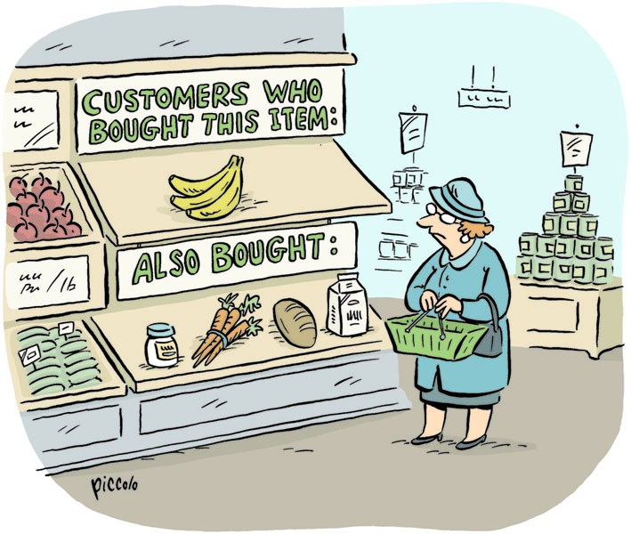
Notes:
A recommender system or a recommendation system is a subclass of information filtering system that seeks to predict the "rating" or "preference" a user would give to an item.
A classic example of recommendation system

Slide 3
Recommendation system
Cutting edge technology
Daily basis we encounter
Increases market revenue
Personalized customer experience
Job market
Notes:
Recommendation system is very hot and can be seen everywhere
During career mosaic earlier last week there were a lot of job opportunities for recommendation system.
In news websites, show related articles;
In shopping websites, show recommended goods, as the famous saying “Customers who bought this item also bought...”;
In every websites, show recommended ads;

Slide 4
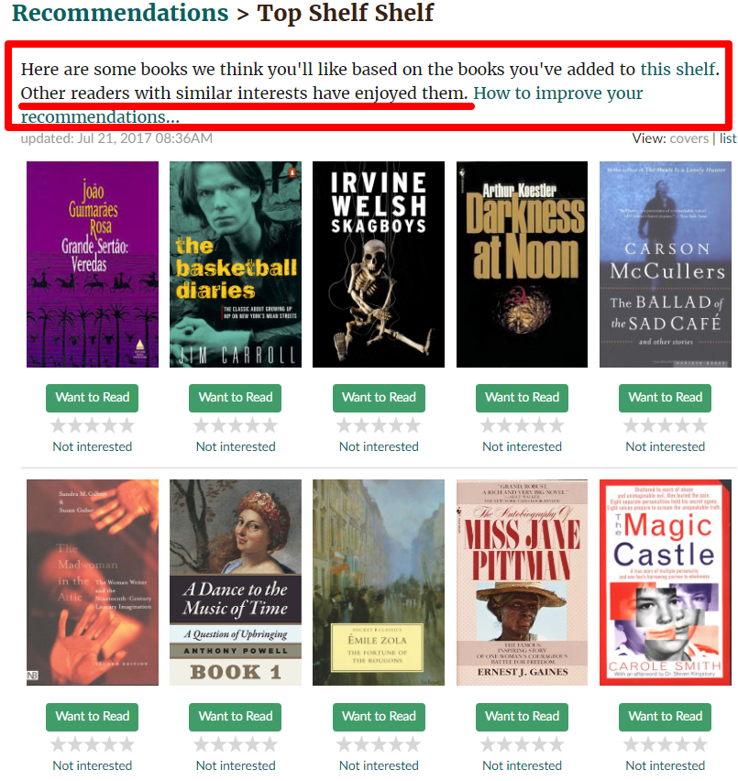
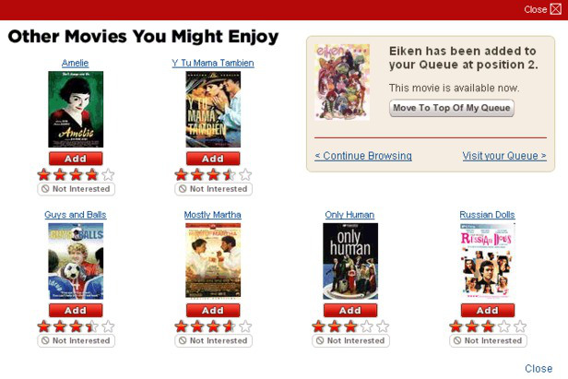
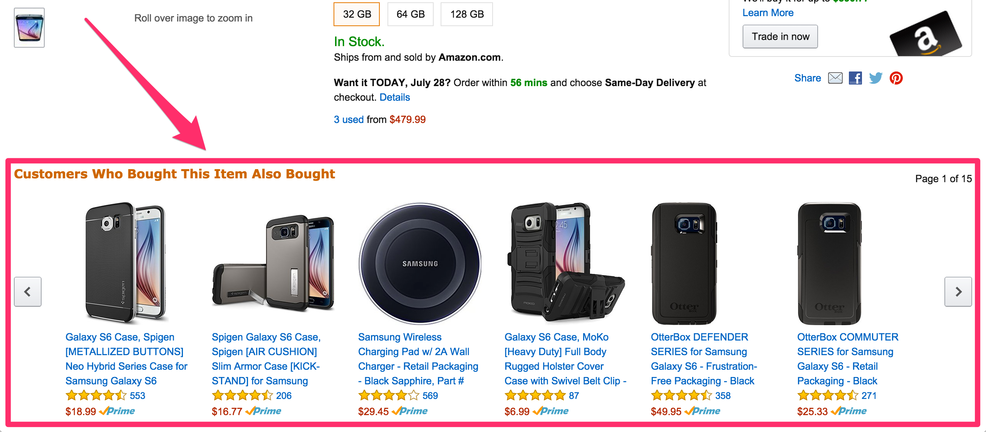

Slide 5
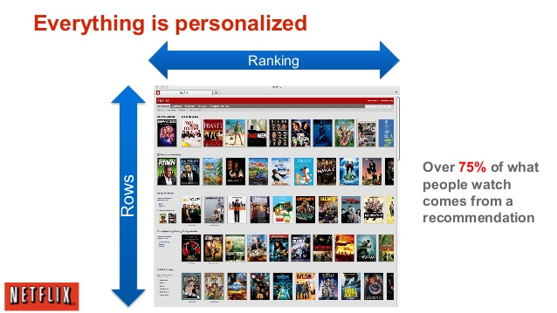
Notes:
personlized

Slide 6
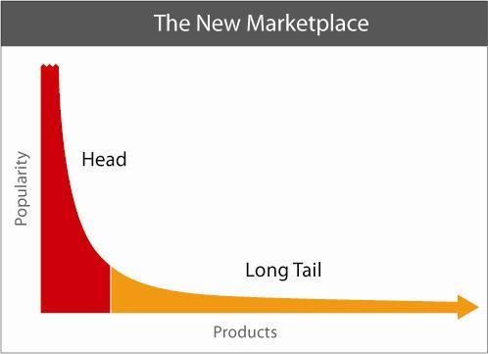
“We are leaving the age of information and entering the age of recommendation”
-Chris Anderson
Notes:
The world is moving from “ one size fits all” solution to personalized solutions
Wired
By using a recommendation and we can space out the users to the long tail.
https://www.ted.com/talks/chris_anderson_of_wired_on_tech_s_long_tail?language=en

Slide 7
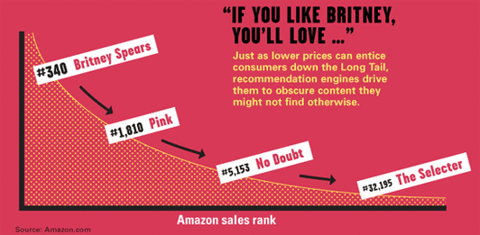
Notes:
https://www.wired.com/2004/10/tail/?pg=2&topic=tail&topic_set=

Slide 8
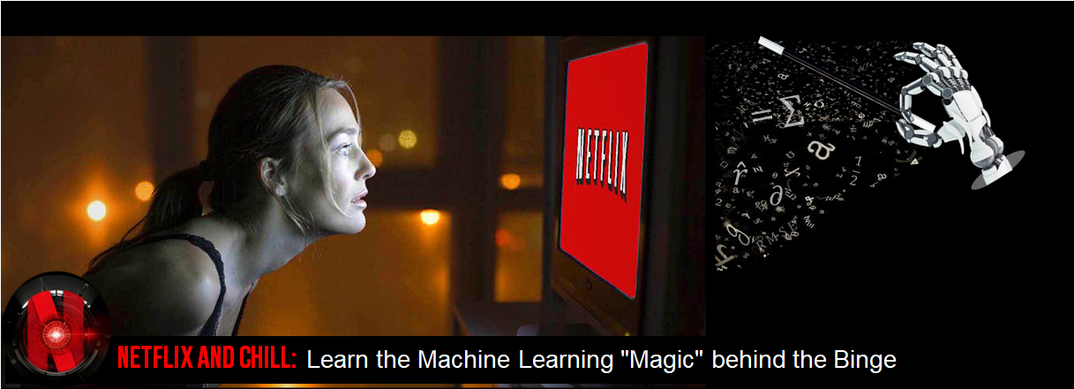
We want to do it too!!!
Notes:
As technology students we were curious , we want to know and try. University is where we can try.
So we have decided to give it a shot.

Slide 9
Goal
To design and build an interactive recommendation system that recommends 5 relevant movies to a user based on the content of the TMDB dataset.

Slide 10
Dataset
Dataset size
45,000 movies
26 million ratings
270,000 users
The content of dataset(features):
cast | crew | plot keywords | budget | revenue | posters
release dates | languages | production companies | countries | TMDB vote counts | vote averages

Slide 11
Plan
Popularity based
Content based filtering
Mainly focus on developing based on these approaches
Notes:
popularity-based engines: usually the simplest to implement be also the most impersonal
content-based engines: the recommendations are based on the description of the products
collaborative filtering engines: records from various users provide recommendations based on user similarities

Slide 12

Popularity based Ranking
Notes:
popularity-based engines: usually the simplest to implement be also the most impersonal

Slide 13
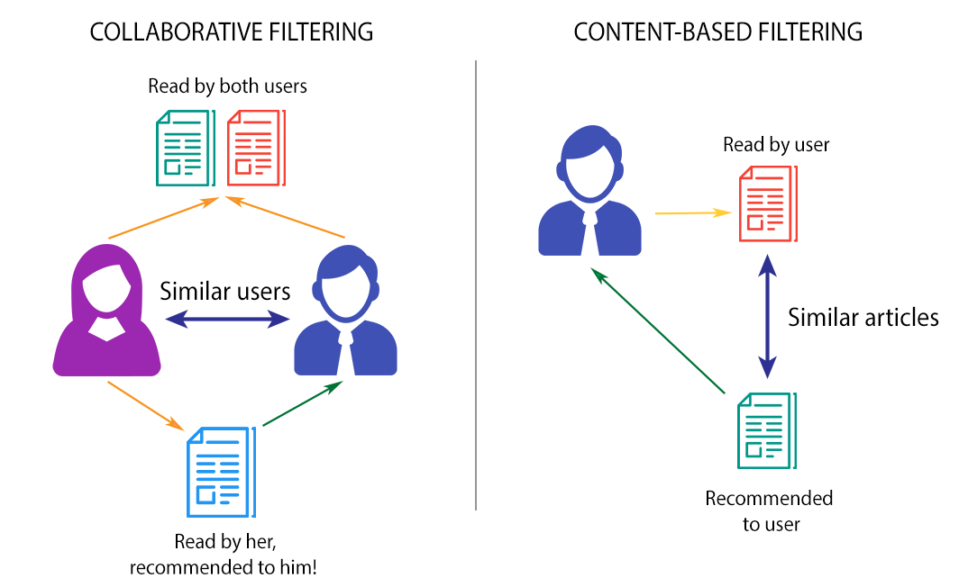
Notes:
content-based engines: the recommendations are based on the description of the products
collaborative filtering engines: records from various users provide recommendations based on user similarities
Collaborative filtering – more difficult problem
Based on time availability.

Slide 14
Schedule
Our schedule is as followed(tentatively):
March 20th – March 31th: Dataset exploration
Acquire Knowledge for the project.
April 1st – April 10th : Data preprocessing
Size reduction/ data integration.
Filling factor.
April 11th – April 30th : Design and develop the recommendation system
Cleaning of the keywords
May 1st – May 8th : Data visualization and Data Analysis.
test-case
Notes:
Our schedule is as followed(tentatively):
March 20th – March 31th: dataset exploration
April 1st – April 10th : data cleaning
April 11th – April 30th : build the recommendation system
May 1st – May 8th : possible improvement and conclusion

Slide 15
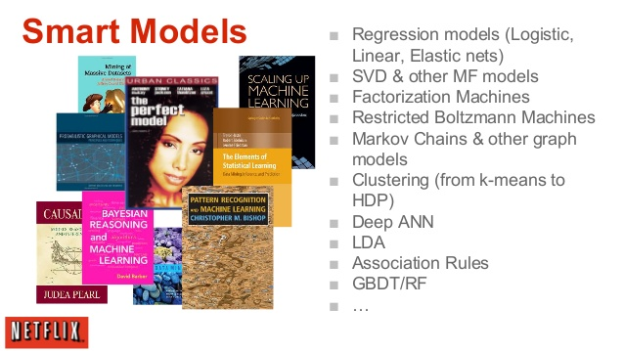
And more……
Notes:
Some models used by Netflix to do the rating we are currently looking into the ones we can implement.
https://www.slideshare.net/InfoQ/machine-learning-recommender-systems-at-netflix-scale

Slide 16


Slide 17
Thank you
Group 7
Supriya Parthiban 20567171
Huang Yi 20538986
LI Yilin 2056 3096
Yan ziqi 20543632
Lu Yao 20552578

